Slide 1

Introduction to

Slide 2
What is firebase?
Firebase is a mobile and web app development platform that provides developers with a plethora of tools and services to help them develop high-quality apps, grow their user base, and earn more profit.

Slide 3

DEVELOP
GROW
Backend Services Realtime Database Authentication Hosting
Storage
Cloud Messaging Remote Config
Acquisition Dynamic Links Invites AdWords
Re-Engagement Notifications App Indexing
Analytics
App Quality Services Test Lab for Android Crash Reporting
EARN
In-app Ads
AdMob

Slide 4
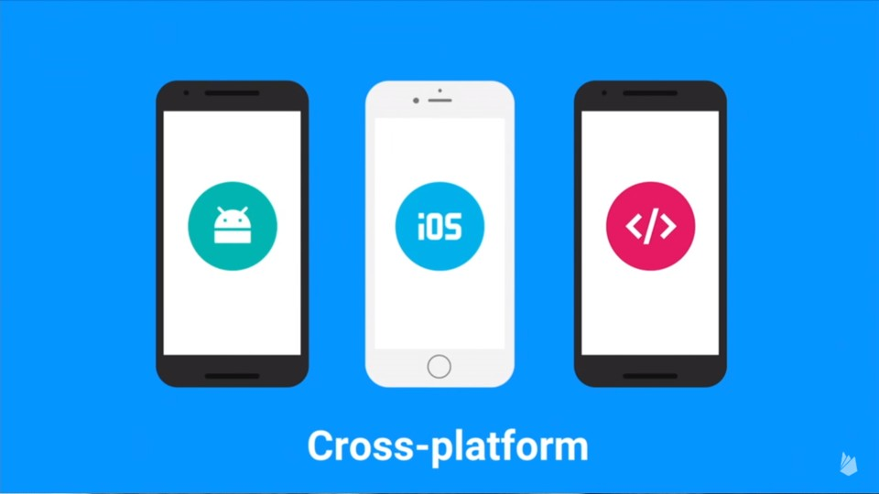

Slide 5
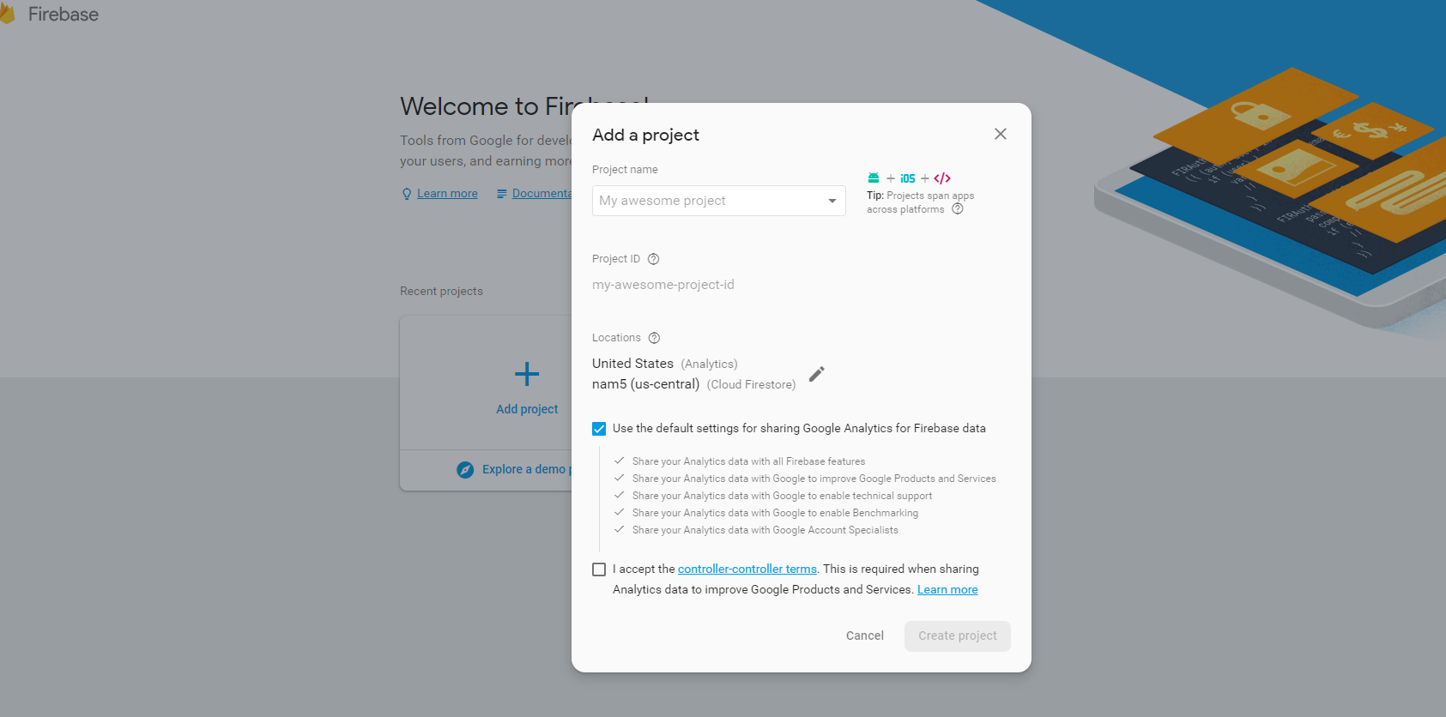
1.1 Setup a project
Create project.

Slide 6
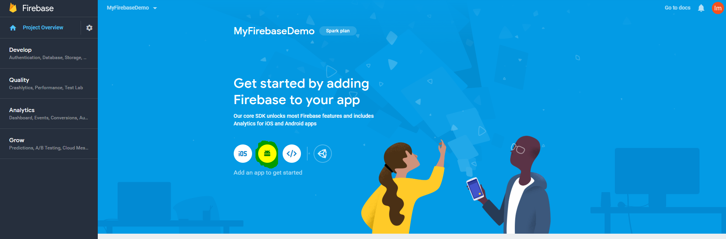
1.2 Setup a project
Select android platform.

Slide 7
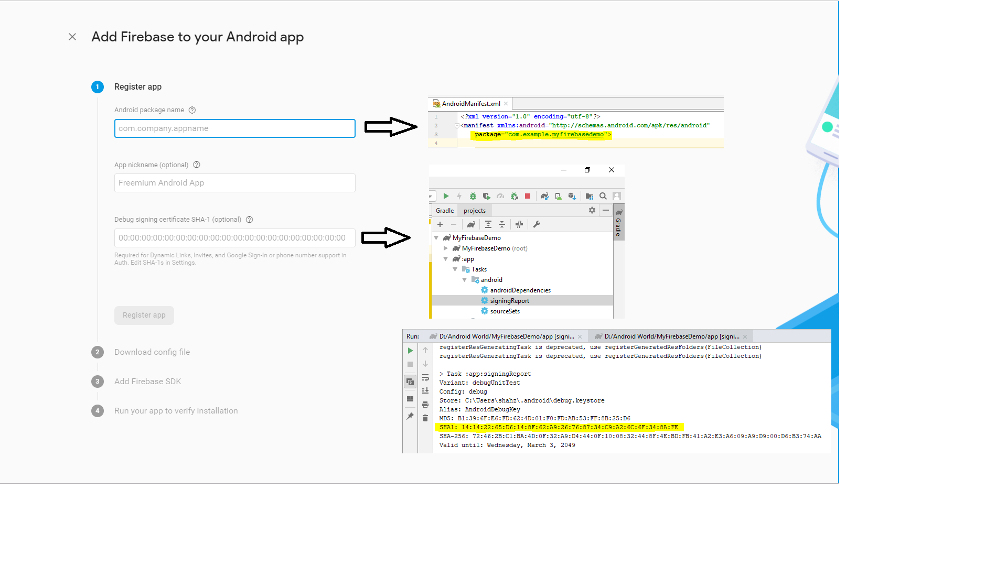
1.3 Setup a project
Register android application.

Slide 8
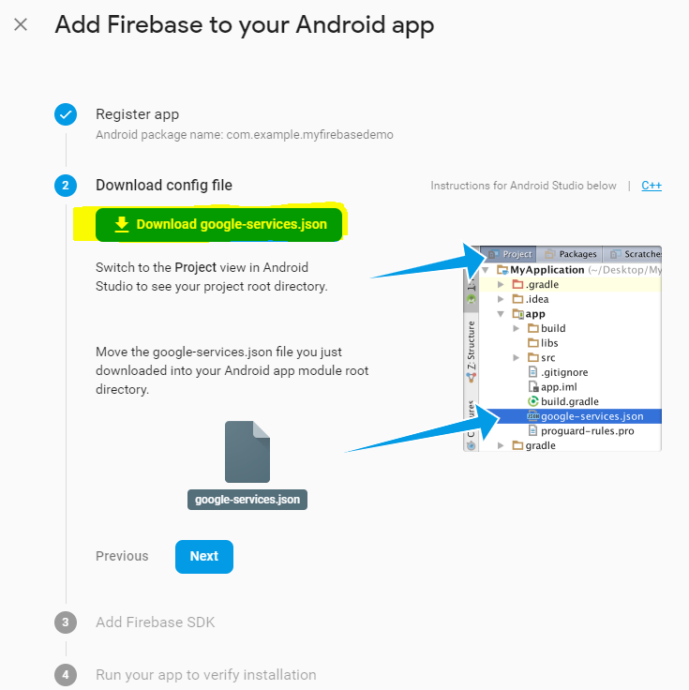
1.4 Setup a project
Download file.

Slide 9
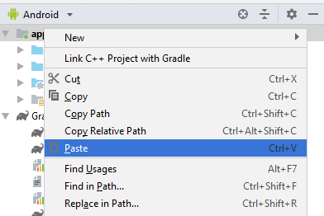
1.5 Setup a project
Paste in app directory.

Slide 10
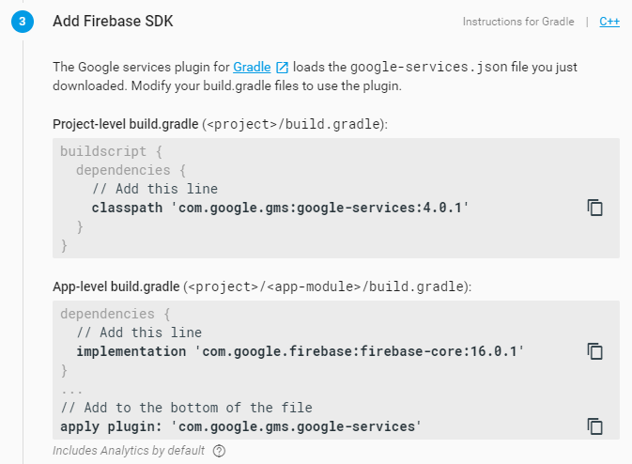
1.6 Setup a project
Integration firebase SDK.

Slide 11
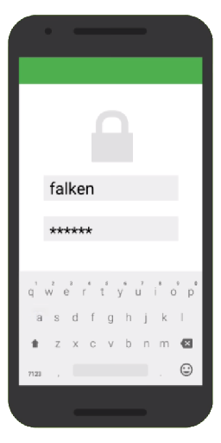

Authentication
Register / Login with
Email + Password
Google
Facebook
Twitter
GitHub
Email address verification
Password reset

Slide 12
Authentication
Add auth library into dependency at gradle
implementation 'com.google.firebase:firebase-auth:16.2.1'
private FirebaseAuth mAuth;
mAuth = FirebaseAuth.getInstance();

Slide 13
Creating User
mAuth.createUserWithEmailAndPassword(email, password)
.addOnCompleteListener(this, new OnCompleteListener<AuthResult>() { @Override
public void onComplete(@NonNull Task<AuthResult> task) {
Log.d(TAG, "createUserWithEmail:onComplete:" + task.isSuccessful()); if (!task.isSuccessful()) {
Toast.makeText(EmailPasswordActivity.this,
"Authentication failed.", Toast.LENGTH_SHORT).show();
}
// ...
}
});

Slide 14
Logging In
mAuth.signInWithEmailAndPassword(email, password)
.addOnCompleteListener(this, new OnCompleteListener<AuthResult>() { @Override
public void onComplete(@NonNull Task<AuthResult> task) { Log.d(TAG, “signInWithEmail:onComplete:" + task.isSuccessful()); if (!task.isSuccessful()) {
Toast.makeText(EmailPasswordActivity.this,
"Authentication failed.", Toast.LENGTH_SHORT).show();
}
// ...
}
});

Slide 15
Sign Out
FirebaseAuth.getInstance().signOut();

Slide 16

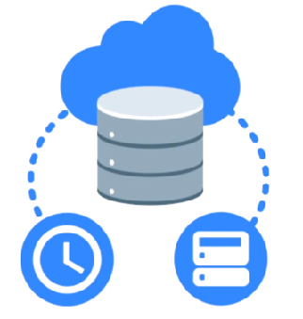
Realtime Database
Cloud-hosted NoSQL database
Synchronization & conflict resolution
Access directly from your app

Slide 17
Realtime Database (Write)
E-g 1:
// Write a message to the database
FirebaseDatabase database = FirebaseDatabase.getInstance(); DatabaseReference myRef = database.getReference("message");
myRef.setValue("Hello, World!");
E-g 2:
String getTitle = title.getText().toString(); String getCategory = category.getText().toString(); String getPrice = price.getText().toString(); Map map = new HashMap<>(); map.put("user_id",FirebaseAuth.getInstance().getCurrentUser().getUid()); map.put("title", getTitle); map.put("category", getCategory); map.put("price", getPrice); DatabaseReference reference = FirebaseDatabase.getInstance().getReference().child("Product").child(getTitle); reference.setValue(map);

Slide 18
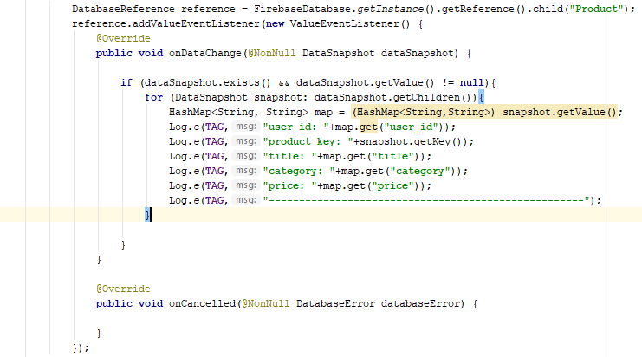
Realtime Database (Read)
// Read from the database
myRef.addValueEventListener(new ValueEventListener() {
@Override
public void onDataChange(DataSnapshot dataSnapshot) {
// This method is called once with the initial value and again
// whenever data at this location is updated.
String value = dataSnapshot.getValue(String.class); Log.d(TAG, "Value is: " + value);
}
@Override
public void onCancelled(DatabaseError error) {
// Failed to read value
Log.w(TAG, "Failed to read value.", error.toException());
}
});

Slide 19
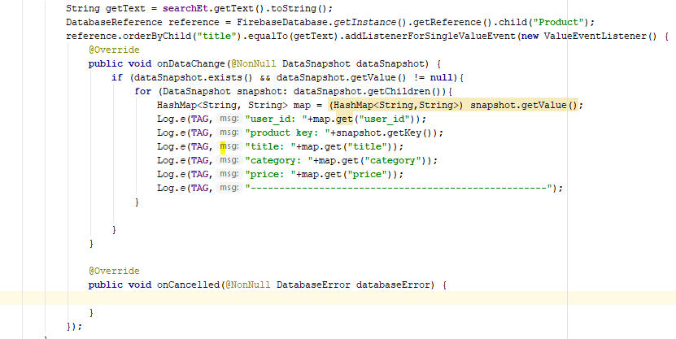
Realtime Database (Search)
Search Item.

Slide 20
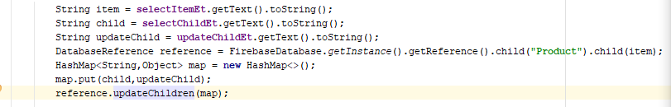
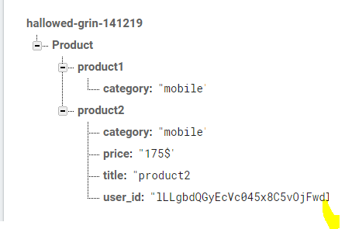
Realtime Database (Update)

Slide 21
Realtime Database (Delete)

Slide 22

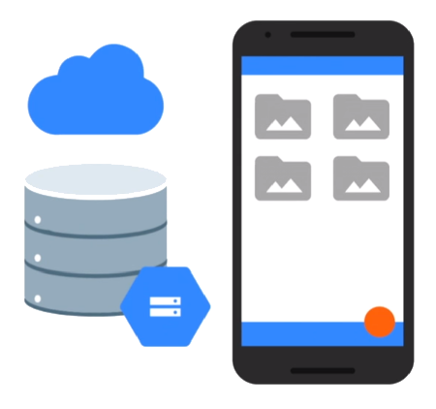
Storage
Easy file storage
Handles poor connectivity
Backed by & accessible from Google Cloud Storage

Slide 23
Storage
FirebaseStorage storage = FirebaseStorage.getInstance();

Slide 24
Uploading a file
Uri file = Uri.fromFile(new File("path/to/images/rivers.jpg"));
StorageReference riversRef = storageRef.child("images/"+file.getLastPathSegment()); uploadTask = riversRef.putFile(file);
// Register observers to listen for when the download is done or if it fails uploadTask.addOnFailureListener(new OnFailureListener() {
@Override
public void onFailure(@NonNull Exception exception) {
// Handle unsuccessful uploads
}
}).addOnSuccessListener(new OnSuccessListener<UploadTask.TaskSnapshot>() { @Override
public void onSuccess(UploadTask.TaskSnapshot taskSnapshot) {
// taskSnapshot.getMetadata() contains file metadata such as size,
// content-type, and download URL.
Uri downloadUrl = taskSnapshot.getDownloadUrl();
}
});

Slide 25
Downloading a file
islandRef = storageRef.child("images/island.jpg");
File localFile = File.createTempFile("images", "jpg"); islandRef.getFile(localFile)
.addOnSuccessListener(new OnSuccessListener<FileDownloadTask.TaskSnapshot>() { @Override
public void onSuccess(FileDownloadTask.TaskSnapshot taskSnapshot) {
// Local temp file has been created
}
}).addOnFailureListener(new OnFailureListener() { @Override
public void onFailure(@NonNull Exception exception) {
// Handle any errors
}
});

Slide 26
Any Question?

